Slide 1

Hr analytics Prediction

Slide 2
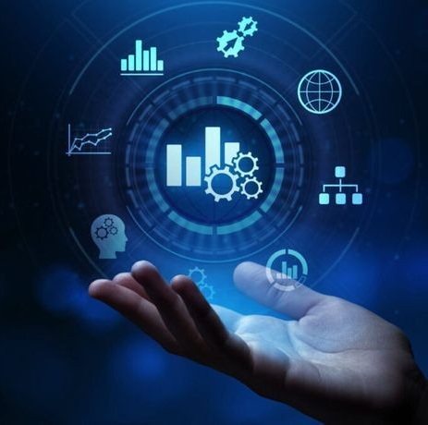
What is Hr analytics?
A process That involves gathering together,analyzing,and reporting HR data in order to improve the Organization workforce performance.
Hr analytics is the Data driven approach to Human Resource Management
It enables Hr professionals to make Data driven Decisions and help to test the effectiveness of HR Policies and different interventions.

Slide 3
How Hr analytics helps in Human resource management?
Make better decisions using Data.
Improved hiring decisions-Recruiters can make Data driven hiring Decisions rather than trusting their intuition.
Improved Hiring Process-Hiring Managers will Know which Position In the Company Require what type of talent,people,background and Experience.
Better Employee Insights-It helps organization look at an employees professional life,by tracking,monitoring,and analyzing performance related data.
More Productive Workforce-It becomes easier to expect and better predict performance and productivity from Employees.

Slide 4
EVOLUTION OF HR ANALYTICS:-
The evolution of hr analytics has come a long way,Organizations today have the ability to track all kinds of metrics to ensure that their people analytics,talent analytics,and work force analytics are effective and accurate.
OBJECTIVE OF HR ANALYTICS:-
The objective is to improve the quality of the people related decisions,in order to improve individual and organizational performance.
Hr analytics plays a role in every aspect of the Hr function,including recruiting,learning/training and devolpment,attrition and benefits.

Slide 5
Project sypnosis:-
HR Analytics (Human Resources Analytics) is the systematic application of data analysis and machine learning techniques to human resources data. It involves collecting, processing, and analyzing data related to various HR functions to gain insights and make informed decisions.
HR Analytics aims to enhance the efficiency and effectiveness of human resource management by providing data-driven solutions for recruitment, performance management, and other HR processes. Through the use of analytics, organizations can identify patterns, trends, and correlations in HR data, enabling them to make strategic decisions that contribute to overall business success.

Slide 6
Problem statement:-
The client is facing a problem in identifying the right people for promotion (only for manager position and below) and prepare them in time.The company needs help in identifying the eligible candidates at a particular checkpoint so that they can expedite the entire promotion cycle.
They have provided multiple attributes around Employee's past and current performance along with demographics. Now, the task is to predict whether a potential promotee at checkpoint in the test set will be promoted or not after the evaluation process.

Slide 7
Tools and technologies
This project utilizes advanced tools such as Tableau and PowerBI for Seamless Data Integration and Interactive Dashboard Design.
Additionally we have used Python Libraries for Machine Learning and dataanalysis are essential for Model Devolpment.The Libraries are pandas,numpyseaborn,matplotlib,scipy,statsmodels,sklearn,Xg boost .
Jupyter Notebook-It is a server client application that allows editing and running notebook documents via web browser,it does not require any internet access.

Slide 8
Working FLOw
START
DATASET COLLECTION
EXPLORING FEATURES
EDA
HYPOTHESIS TESTING
FINALIZED MODEL
EVALUATION METRICS
MODEL BUILDING
DATA PREPROCESSING

Slide 9
DATASET COLLECTION:-
Collecting data allows you to capture a record of past events so that we can use data analysis to find recurring patterns. From those patterns, you build predictive models using machine learning algorithms that look for trends and predict future changes.
In this module, we collect the data from Analytics Vidhya. This dataset contains the information of employee and his performance in the industry.
Here we have two different Datasets which are train and test Dataset,The model should be build on Train Dataset and predictions should be made of Test Dataset.

Slide 10
PRE PROCESSING
Data pre-processing is a process of preparing the raw data and making it suitable for a machine learning model. A real-world data generally contains noises, missing values, and maybe in an unusable format which cannot be directly used for machine learning models.
Here missing values are replaced with Median and dropped the Unwanted columns which does not have effect on the Target Variable.
Feature Encoding-Converted the categorical features into a suitable format for machine learning algorithms to process effectively.

Slide 11
MODEL BUILDING
Here we have build the Different Classification Models on the Train Data,Those models are..
Logistic Regression
Decision Tree
Random Forest
KNN
SVC
Gradient Boost
XG Boost

Slide 12
Evaluation metrics
These metrics provide insights into how well the model is performing and help in comparing different models or algorithms.
Confusion Matrix.
Classification Report.
Classification Accuracy.
Area under Curve.
F1 score.

Slide 13
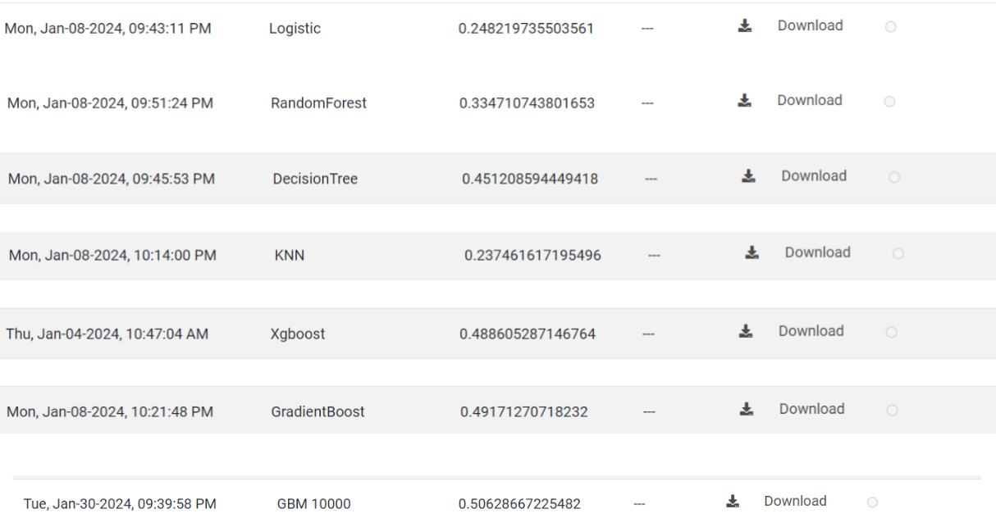
PERFOrmance Evaluation

Slide 14
Risks and Challenges
Since the dataset consists of 54k rows and 14 columns ,Analyzing the data is
challenging.
Feature Engineering,Feature Selection.
Data is imbalanced ,So the predictions of lower category is low.
Overfitting the models.
Model Building and Choosing the best model among others Consumed more time.

Slide 15
CONCLUSION
In conclusion, Through the systematic application of data analytics and predictive modeling, this project aims to revolutionize our approach to workforce planning, recruitment, and employee engagement.The tree models like Decision Tree ,Gradient Boost,Xg boost works well on the data.The Best Among these are XG boost which have good accuracy,Precision,F1 score on the Train Data.Gradient works good on the Test Data.These Findings can help the hr managers and businesses to make data-driven decisions more productively.So the client can easily promote /Not promote the employee based on the eligibility.In the Future we can expect to see more research focused Hr analytics with other ai technologies to create more intelligent and responsive applications.

